Slide 1
Technical Writing
Unit 2

Slide 2

Informative Summaries
What is a summary?
A short description of a document or a text
A succinct statement (synopsis) that gives only the main ideas of sth
A shortened passage, which retains the essential information of the primary document
Stands for the original source (not personal interpretation)
Should be concise, accurate, neutral, readable and reliable
Paraphrasing is a prominent technique of a summary writing
We look for 5W1H while paraphrasing a text
Steps: Introducing the author, the article, and its main idea; Recognize the topic sentences and the supporting details; Provide a short conclusion

Slide 3
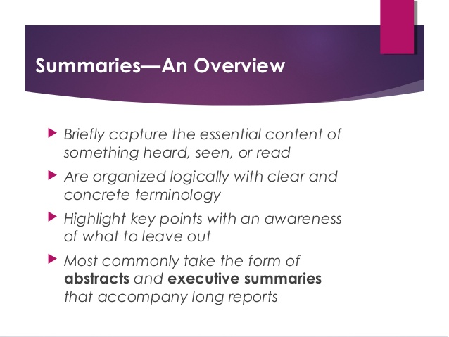

Slide 4
Cut and dried
Usually appears at the end of an article or report
Writers reword and condense ideas (vs Plagiarism)
Acts as an extended title
Helps readers to see if the report or paper contains information they need (Should I read?)
To tell readers exactly what the paper is about (not to lose the readers)
A short version of the report
Picks out for the reader-in-a-hurry just those key words, phrases, facts and conclusions which the author knows are the ones which matter
A ‘map’ of the paper
A mystery tour along a dry, dusty road (attention on the main direction of the argument)
Helps readers to remember the paper (memory/reminder via reinforcement)

Slide 5
Precis | Summary | Abstract
A clear, and condensed summary of a text | A straightforward, brief presentation | A one or two sentence summary that includes the author's name, publication (source) and date, titles and subtitles and keywords
Gives absolute main points | Gives all points in short | Only essential facts or views
Usually has a fixed word length (around 100): writers work within an arbitrary limit on the number of words | No fixed word length: the length should be a balance between the amount of important information and the reader’s available time | Almost same size as summary-300 words
Less reliable (shortens everything) | More trustworthy | Trustworthy
Writer-focused: an exercise for the writer | Reader-focused: helps the reader do a job *More open ended than abstracts | A condensed overview of a paper; helps to identify the purpose of the paper, major findings and conclusion of the paper

Slide 6
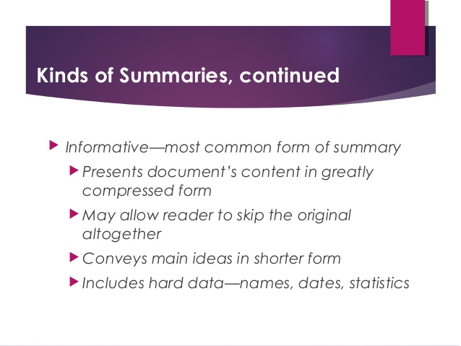

Slide 7
Descriptive Summary | Informative Summary
Describes what is in the report | Does not simply describe what will be in the report: it gives a selection of information
States clearly: ‘this is what is in the report’ (brief) | Extends the title (gives all the possible clues)
Leaves readers guessing; not specific | Readers would be clear: are not left guessing; very specific and complete
Arouses readers’ curiosity, but must read the entire paper to get facts (Time factor neglected) | The informative summary is complete in itself; it does not point outside itself; readers who have not got time to read the whole report are given hard facts

Slide 8
Write summaries informatively
The writers should work hard not the readers
Informative summaries use words efficiently (active; not redundant)
IS are more useful
They can use numbers: Qualitative words are vague, and leave different readers with different impressions E.g.: 'surveys show that the range of increased earnings was between 16% and 49%, with a median value of 31.7% in the period 1985–87’.
Fewer words; clearer ideas
The figures in the summary do not have to be the same as the figures in the report (Give approximate or average figures)

